Slide 1
Repeating Cut-And-Run Analysis
Molecular basis of polycomb group protein-mediated fetal hemoglobin repression
PMID: 36893455
Based on Qin et al., Blood 2023

Slide 2
NGS Data Processing Comparison
Manuscript: Cut-and-Run 2.0 pipeline
- Adaptor trimming: Trimmomatic
- Mapping: Bowtie2
- Fragment shift for Cut-and-Run: deepTools’ ATAC Shift
- PCR and optical duplicate removal: Picard
- Peak calling: MACS2
- Differential binding analysis: DiffBind
My Pipeline: Recapitulates Cut-and-Run 2.0
Exceptions:
- MACS2 was replaced with MACS3
- Consensus peaks were called using IDR
- Peak annotation by ChIPSeeker

Slide 3
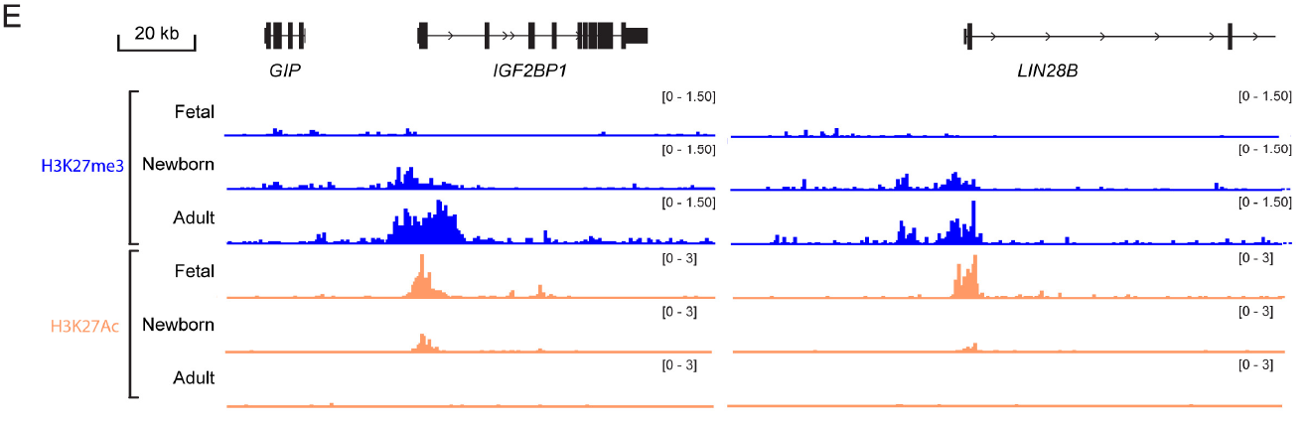
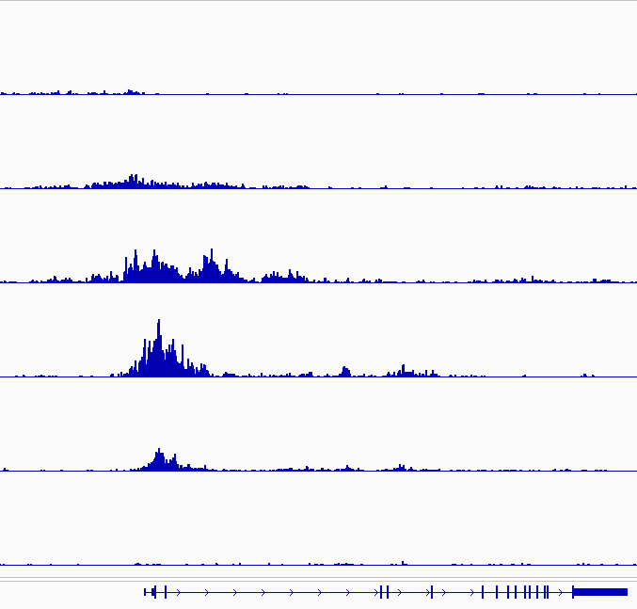
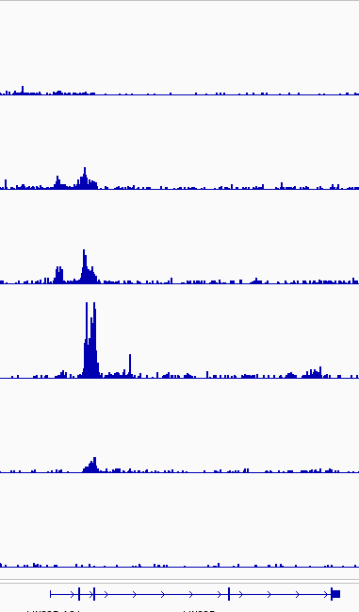
Benchmarking: Figure 5E
5E
Manuscript
Fetal
H3K27me3
Newborn
Re-analysis with
my pipeline
Adult
Fetal
H3K27Ac
Newborn
Adult
IGF2BP1
LIN28B

Slide 4
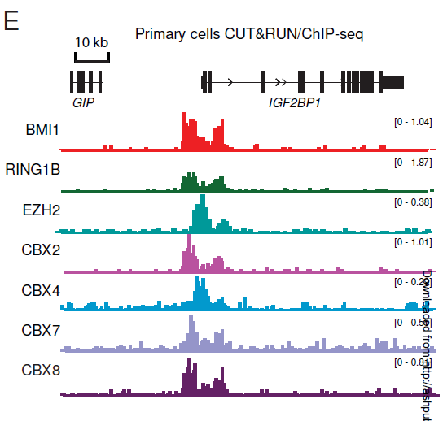
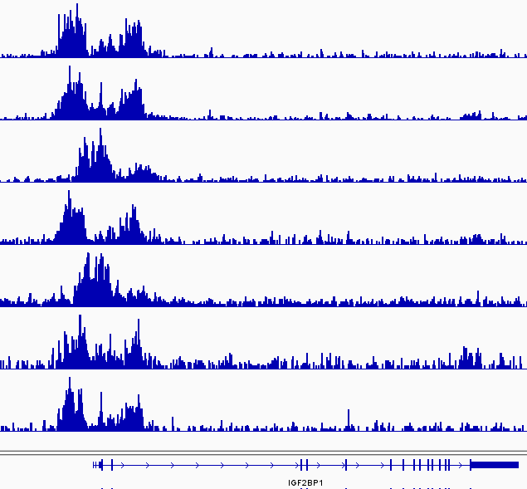
Benchmarking: Figure 6E
6E
Manuscript
My Analysis

Slide 5
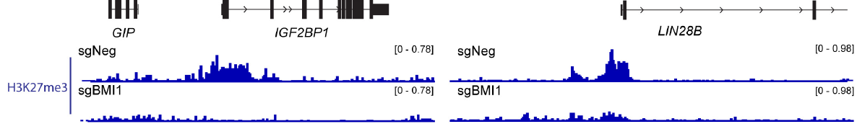
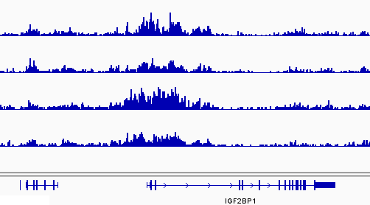
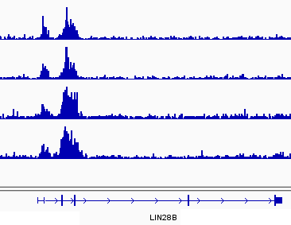
Benchmarking: Figure 5D
5D
Manuscript
*
*
sgNeg
sgNeg
Rep1
*
*
sgBMI1
sgBMI1
QIAGEN Analysis
sgNeg
Rep2
sgBMI1
*
*
All tracks: 0 - 0.78
Note: sgBM1 results do not match published figure suggesting
a possible error by the authors.

